Slide 1
Asymptotic Analysis

Slide 2
Why Bother?
Resource Analysis
Runtime, memory, power, etc.

Slide 3
Asymptotic Analysis
What is the difference between $18 Trillion and $(18 Trillion + 500)?
Numbers of Facebook users in billions, nearly all major apps in millions, operations on a home PC in trillions (all per day)

Slide 4
How To Compare?
Asymptotic
O, o, Ω, ω, Θ
Best-Worst-Average Case
Basic vs Amortized

Slide 5
Asymptotic Analysis
Type | Pronounced | Meaning (order of) | Examples
O(n) | Big-O | ≤ c*n | 5n, log(n), 1
o(n) | Little-o | < c*n | log(n), 1
Ω(n) | Big-Omega | ≥ c*n | 5n, 100n², n!
ω(n) | Little-Omega | > c*n | 100n², n!
Θ(n) | Theta | = c*n | 5n, 100n, 0.01n

Slide 6
Asymptotic Analysis
O(n²) | ≤ k*n²
o(n) | < k*n
Ω(n³) | ≥ k*n³
ω(n^{1.5}) | > k*n^{1.5}
Θ(log(n)) | = k*log(n)

Slide 7
Asymptotic Analysis
Type | Pronounced | Examples
o(n) | Little-o | log(n), 1
O(n!) | Big-O | 5n! + 4n², log(n), 1
Θ(n³) | Theta | 16n³ + 4n² - 2n, 12n³
Ω(2^{n}) | Big-Omega | 4*2^{n}, n!
ω(n²) | Little-Omega | 100n³, n⁴, 6n¹⁰⁰, n!

Slide 8
Example
n² + 2n - 1?
o(n³), o(n⁴), o(2^{n})
O(n²), O(n³), O(n⁴)
Θ(n²)
Ω(n²), Ω(n),Ω(log n), Ω(1)
ω(n),ω(log n), ω(1)

Slide 9
Expectations
for i = 1:n
for j=1:n
Do 1 operation
o(n³), o(n⁴), o(2^{n})
O(n²), O(n³), O(n⁴)
Θ(n²)
Ω(n²), Ω(n),Ω(log n), Ω(1)
ω(n),ω(log n), ω(1)

Slide 10
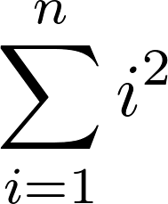
Expectations
?
_{n}C_{r} ?
Notes:
Θ(n³) (sum i² = ⅙ n(n+1)(2n+1)
nCr is n(n-1)(n-2)... r times, so it is order n^{r} - i.e. Θ(n^{r})

Slide 11
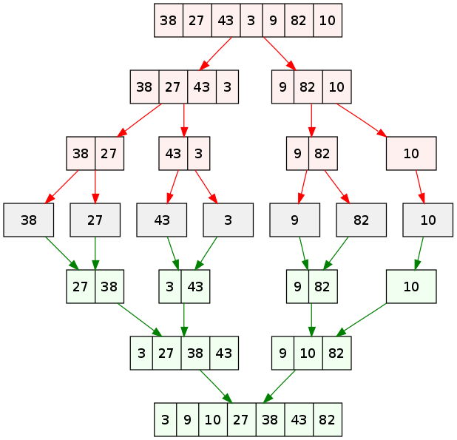
How Do I Get log(n)?
Divide by a factor at each step

Slide 12
How To Compare?
Asymptotic
O, o, Ω, ω, Θ
Best-Worst-Average Case
Basic vs Amortized

Slide 13
Complexity | Name | Example
Θ(1) | Constant | Insert element at end of array
Θ(log(n)) | Logarithmic | Binary search (sorted)
Θ(n) | Linear | Naive search for maximum value (unsorted)
Θ(n log(n)) | n log n | Mergesort
Θ(n²) | Quadratic | Two nested loops
Θ(n^{k}) - really, O(n^{k}) | Polynomial | Matrix multiplication
Θ(2^{n}) - really, O(2^{n}) | Exponential | Check for subset
Θ(n!) - really, O(n!) | Factorial | Generate all permutations

Slide 14
Complexity | Name | Example
Θ(1) | Constant | Insert element at end of array
Θ(log(n)) | Logarithmic | Binary search (sorted)
Θ(n) | Linear | Naive search for maximum value (unsorted)
Θ(n log(n)) | n log n | Mergesort
Θ(n²) | Quadratic | Two nested loops
Θ(n^{k}) - really, O(n^{k}) | Polynomial | Matrix multiplication
Θ(2^{n}) - really, O(2^{n}) | Exponential | Check for subset
Θ(n!) - really, O(n!) | Factorial | Generate all permutations

Slide 15
How To Compare?
Asymptotic
O, o, Ω, ω, Θ
Best-Worst-Average Case
Basic vs Amortized

Slide 16
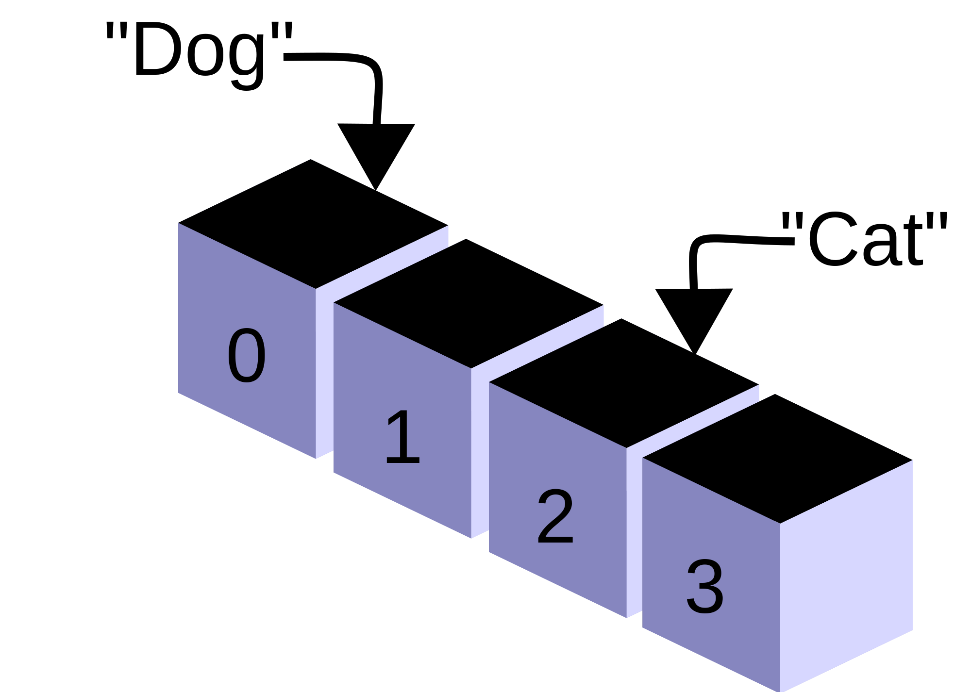
Linear search example
Case | Exact | Order | How
Best | 1 | O(1) | Picked input
Worst | n | O(n) | Picked input
Average | (n+1)/2 | O(n) | Uniform distribution on input

Slide 17
Master Theorem T(n) = a T(n / b) + f(n)
T(n) = 4 T(n / 2) + O(n)
log_{b}(a) = log₂(4) = 2
Power of f(n) = 1
2 > 1
ANSWER: Θ(n²)

Slide 18
Master Theorem T(n) = a T(n / b) + f(n)
T(n) = 4 T(n / 2) + O(n³)
log_{b}(a) = log₂(4) = 2
Power of f(n) = 3
2 < 3
ANSWER: Θ(n³)

Slide 19
Master Theorem T(n) = a T(n / b) + f(n)
T(n) = 2 T(n / 2) + O(n)
log_{b}(a) = log₂(2) = 1
Power of f(n) = 1
1 = 1
ANSWER: Θ(n log(n))

Slide 20
Master Theorem T(n) = a T(n / b) + f(n)
T(n) = a T(n / b) + f(n)
Always works IF
a is a number >= 1 (no variables, no negatives, no fractions less than 1)
f(n) is positive and is order n^{k} log^{j}(n)

Slide 21
How To Compare?
Asymptotic
O, o, Ω, ω, Θ
Best-Worst-Average Case
Basic vs Amortized

Slide 22
Amortized Analysis
Amortize:
To pay a cost gradually by paying a little at a time
Aggregate Method
Find an upper bound T(n) that holds for every sequence of n operations
The cost of a single operation is T(n)/n
Any n operations take O(n) time:
O(1) amortized
Any n operations take n³ time:
O(n²) amortized

Slide 23
Amortized Analysis
... ⅛ + ¼ + ½ + 1
0 | 0 | 0 | 0 | 0 | 0
0 | 0 | 0 | 0 | 1 | 1
0 | 0 | 0 | 1 | 0 | 2
0 | 0 | 0 | 1 | 1 | 3
0 | 0 | 1 | 0 | 0 | 4
0 | 0 | 1 | 0 | 1 | 5
0 | 0 | 1 | 1 | 0 | 6
0 | 0 | 1 | 1 | 1 | 7
0 | 1 | 0 | 0 | 0 | 8
0 | 1 | 0 | 0 | 1 | 9
0 | 1 | 0 | 1 | 0 | 10
0 | 1 | 0 | 1 | 1 | 11
0 | 1 | 1 | 0 | 0 | 12
0 | 1 | 1 | 0 | 1 | 13
0 | 1 | 1 | 1 | 0 | 14
0 | 1 | 1 | 1 | 1 | 15
1 | 0 | 0 | 0 | 0 | 16
T(n) = Cost of n operations:
n*(1 + ½ + ¼ + ⅛ + ...)
< 2n
Amortized cost = T(n) / n
= 2
O(1)

Slide 24
Summary
Asymptotic analysis is quick estimate and hardware independent
Amortized analysis lets you average cost over n operations
Only leading-order term matters
“Good” depends on area, but usually ≤ n log(n)

